Slide 1
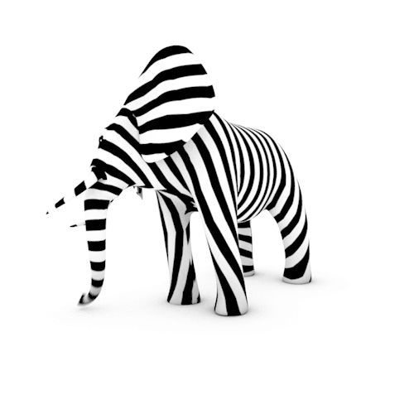
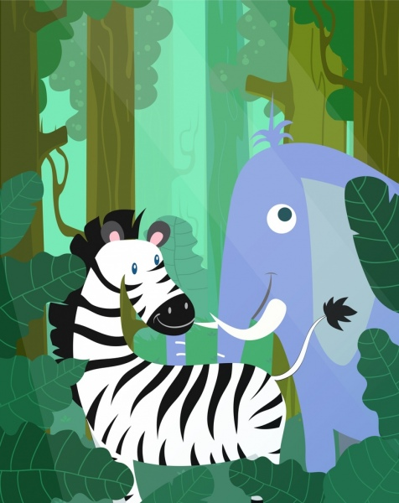
Image Classification: Zebra vs Elephant with Computer Vision Techniques
DS 862: Machine Learning
INSTRUCTOR:
Prof. Rex Cheung
BY:
Swati Kohli
Poonam Patil

Slide 2
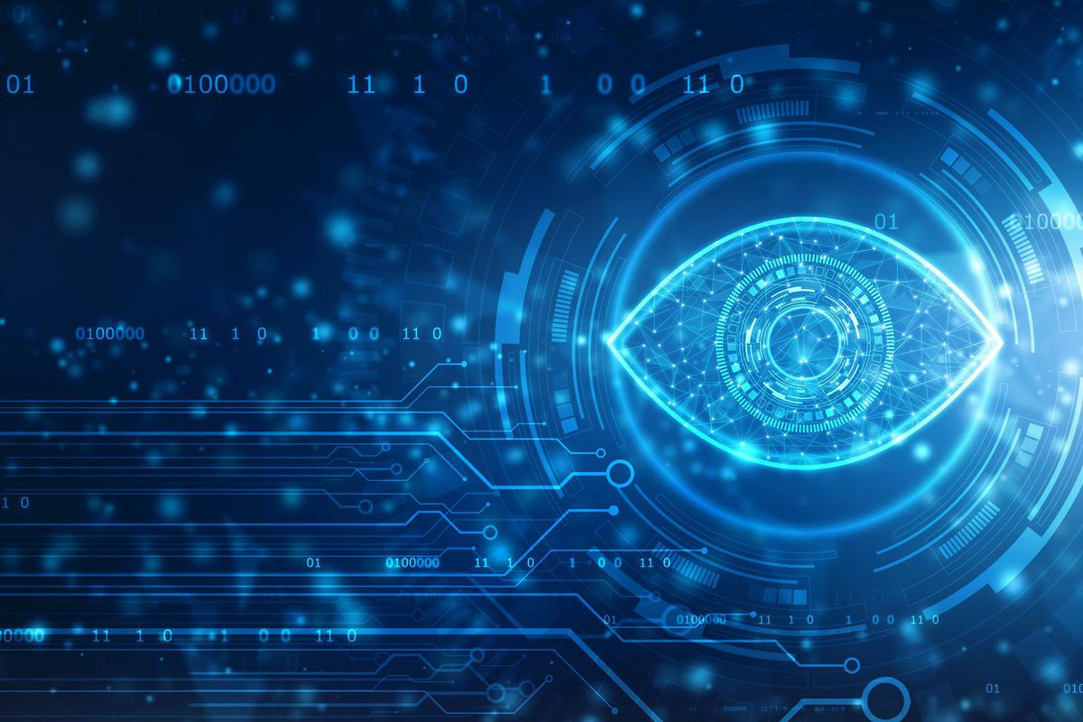




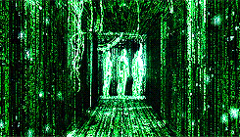
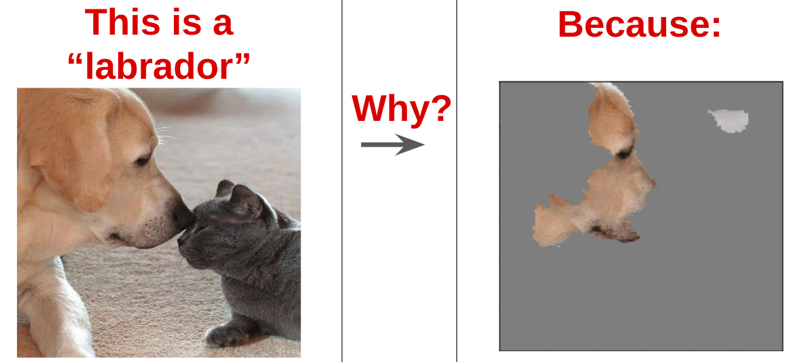
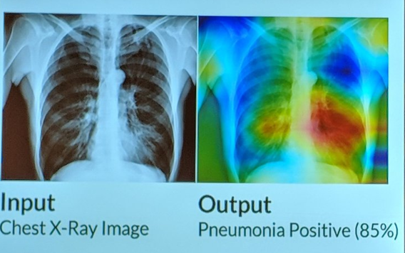
About Computer Vision
Computer Vision
Computer + Vision
= Human + Vision
Objective
Explore + Implement
In Image Classification
Need
Large Data
Automate task
Application
Medical Diagnosis
E-commerce retail
Notes:
Computer vision as the name suggests is computer and vision. Meaning how computers “see” and understand the content of images to reproduce the capability of a human vision
Our objective is to Explore and implement some computer vision techniques to do image classification
Whats the need? Manually checking and classifying images could be a tedious task for a large data and therefore it is useful to automate this process using computer vision.
Detect diseases e.g. predicting Covid-19 cases from chest X-ray images (binary classification)
Classify apparel (shirt, trousers, shoes, etc.)

Slide 3
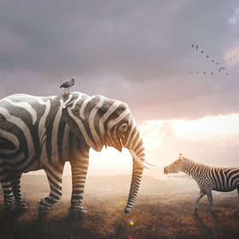
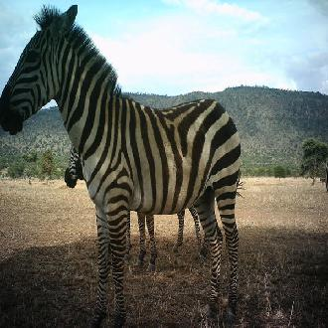
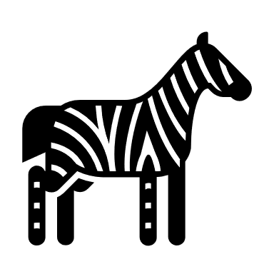

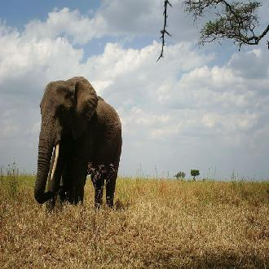

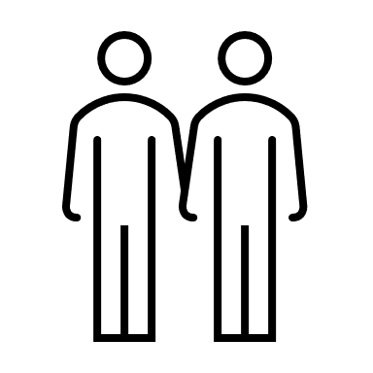
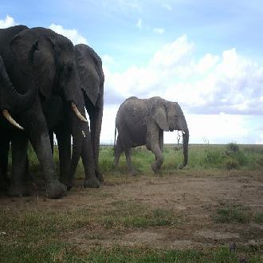
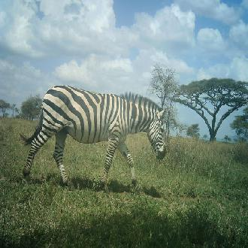
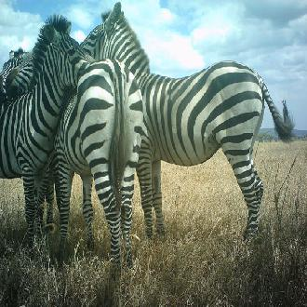
Project
Task
Binary classification
Project Link:
Zindi
Data : 330 x 330 Image
Source : Tanzania’s Serengeti National Park
Study Objective: Herbivore Co-existence
Metric used: Accuracy
Zebra : 0 Elephant : 1
14,000
Notes:
The project is a binary classification to distinguish zebras from elephants
Project source is Zindi Knowledge Competition from August 2019
Image resized to 330x330 pixels in original data.
Pictures were taken in… Why classifying them? Both are herbivores and Objective is to study these images to investigate how do herbivores coexist for which image classification is a crucial step to identify zebra from elephants.

Slide 4
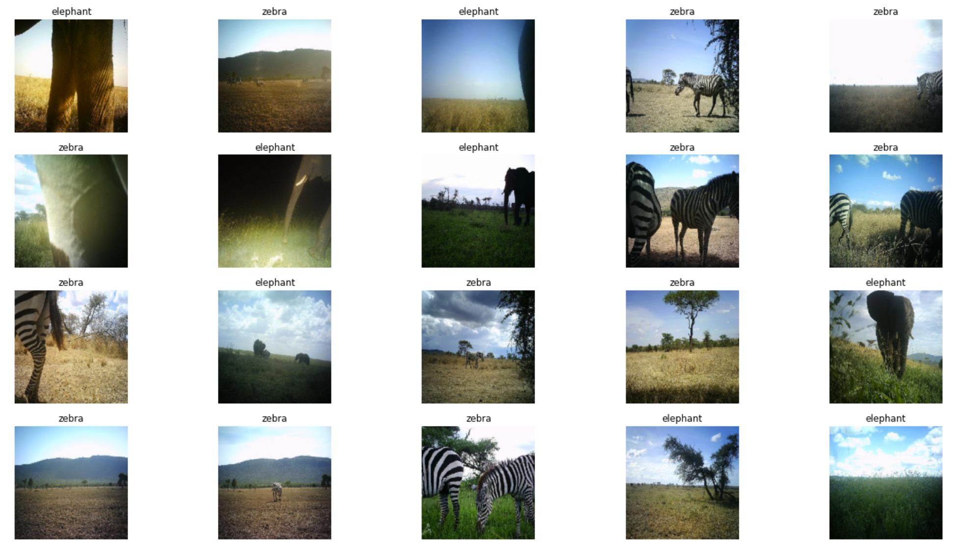
Visualize Samples
Pictures : 255 cameras
Trigger: Infrared + motion sensors
Observation: Some images hard to identify
Reason: Tall sunlit grass may trigger click
Notes:
pictures were taken through 255 cameras that were triggered by a combination of infrared and motion sensors taking three consecutive images, after which the trigger was blocked for one minute.
Notice, in some images even though the data is labelled, it is hard to make out if the image has an elephant or zebra in it. This is because,a tall grass that is sunlit can also trigger the camera when it blows in the wind.

Slide 5
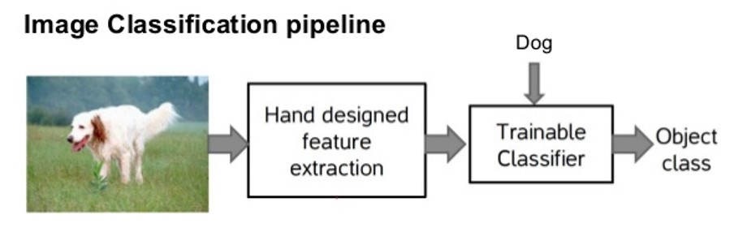





Tasks
1. Image Preprocessing: Improve features
a. Image to Numbers
b. Reduce distortions
c. Enhance important features
2. Detect object – localization/segmentation for positioning object
a. Identify patterns
b. Learn unique features to
c. Differentiate between classes
3. Feature extraction & Modeling
4. Train/Test & Classification.
a. Statistical or deep learning methods
b. Compare img patterns with target ones
c. Differentiate between classes
Example How computers see an ‘8’
Image Source
Notes:
1. Image Preprocessing - Aim- Improve the image features converting to numbers (reading + resizing image), suppress unwanted distortions or enhance some significant features through image augmentation. 2. Detection of an object – localization/segmentation of image to identify the position of the object 3. Feature extraction and Training - Crucial step Statistical or deep learning methods to: a. Identify patterns in the image b. Learn features that might be unique to a particular class to differentiate between classes 4. Classification of the object – categorization of detected objects into predefined classes by comparing image patterns with the target patterns.

Slide 6
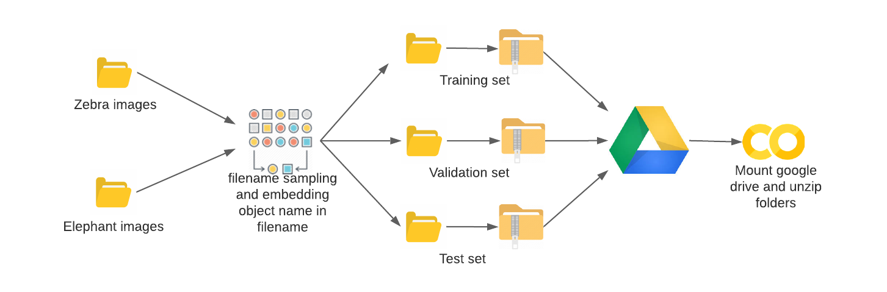
Data sampling and loading
Data : 14000 images
Train Valid Test set: 1000 + 400 + 400 (Equal Class) One-time Random selection
Add labels in filename
New Dataset : Google Drive
Project Implementation: Google Colab – GPU
Notes:
Image sampling is done outside of modeling task to save memory usage by intermediate dataframes in the working notebook

Slide 7
Overall Approach
Data pre-processing
+
Augmentation
2. Performance of different Machine Learning techniques like:
Logistic Regression
K nearest neighbor Classifier
Random Forest & SVM
Convolutional Neural Network
Transfer Learning (ResNet50
InceptionV3)
Part 1
Part 2
Notes:
Read the image , resize it to Establish a base size based on image sources
Then Data Augmentation

Slide 8
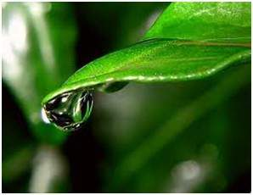
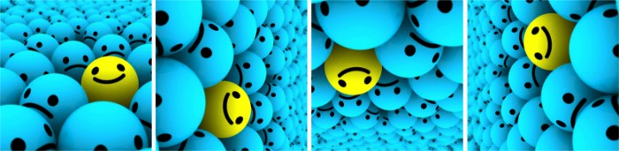
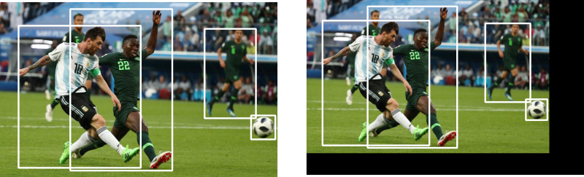
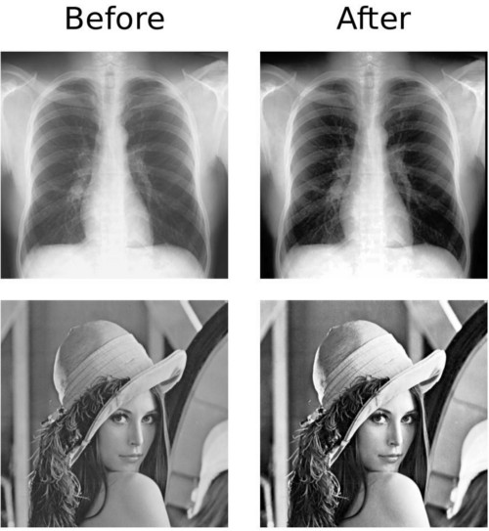
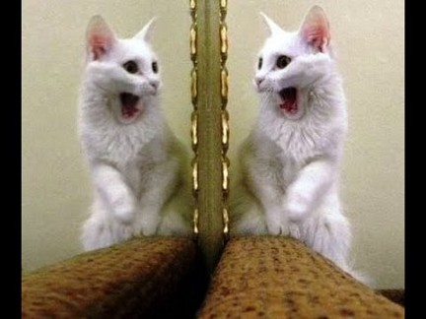
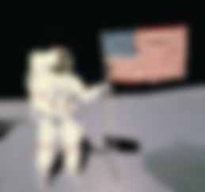
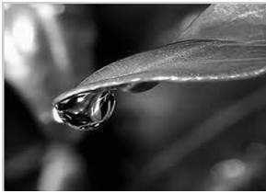
Data Augmentation
Gray scaling of image
Reflection/Flip
Gaussian Blurring
To reduce image noise
Histogram Equalization-
Increase global contrast using image intensity histogram
No parameter required but might give an unnatural looking image
Rotation
Translation
Moving image along X or Y (or both)
Useful object location
Forces feature extractor to look everywhere
Notes:
Various techniques to Modify images with different orientations –
Useful as most objects can be located anywhere in the image
Generates more data from limited data
Prevents overfitting
In part 1 we used the approach of augmentation through gray scaling

Slide 9
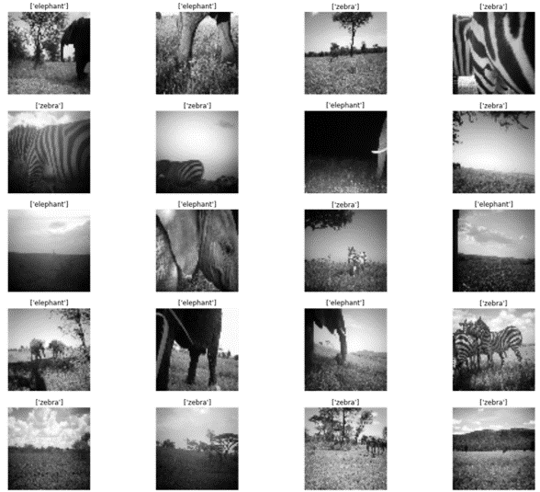





Part 1 : Approach
Load images
Resize : 330 -> 64
Augmentation: Grayscale
Standardize (0-1 scale)
Label encoding

Slide 10

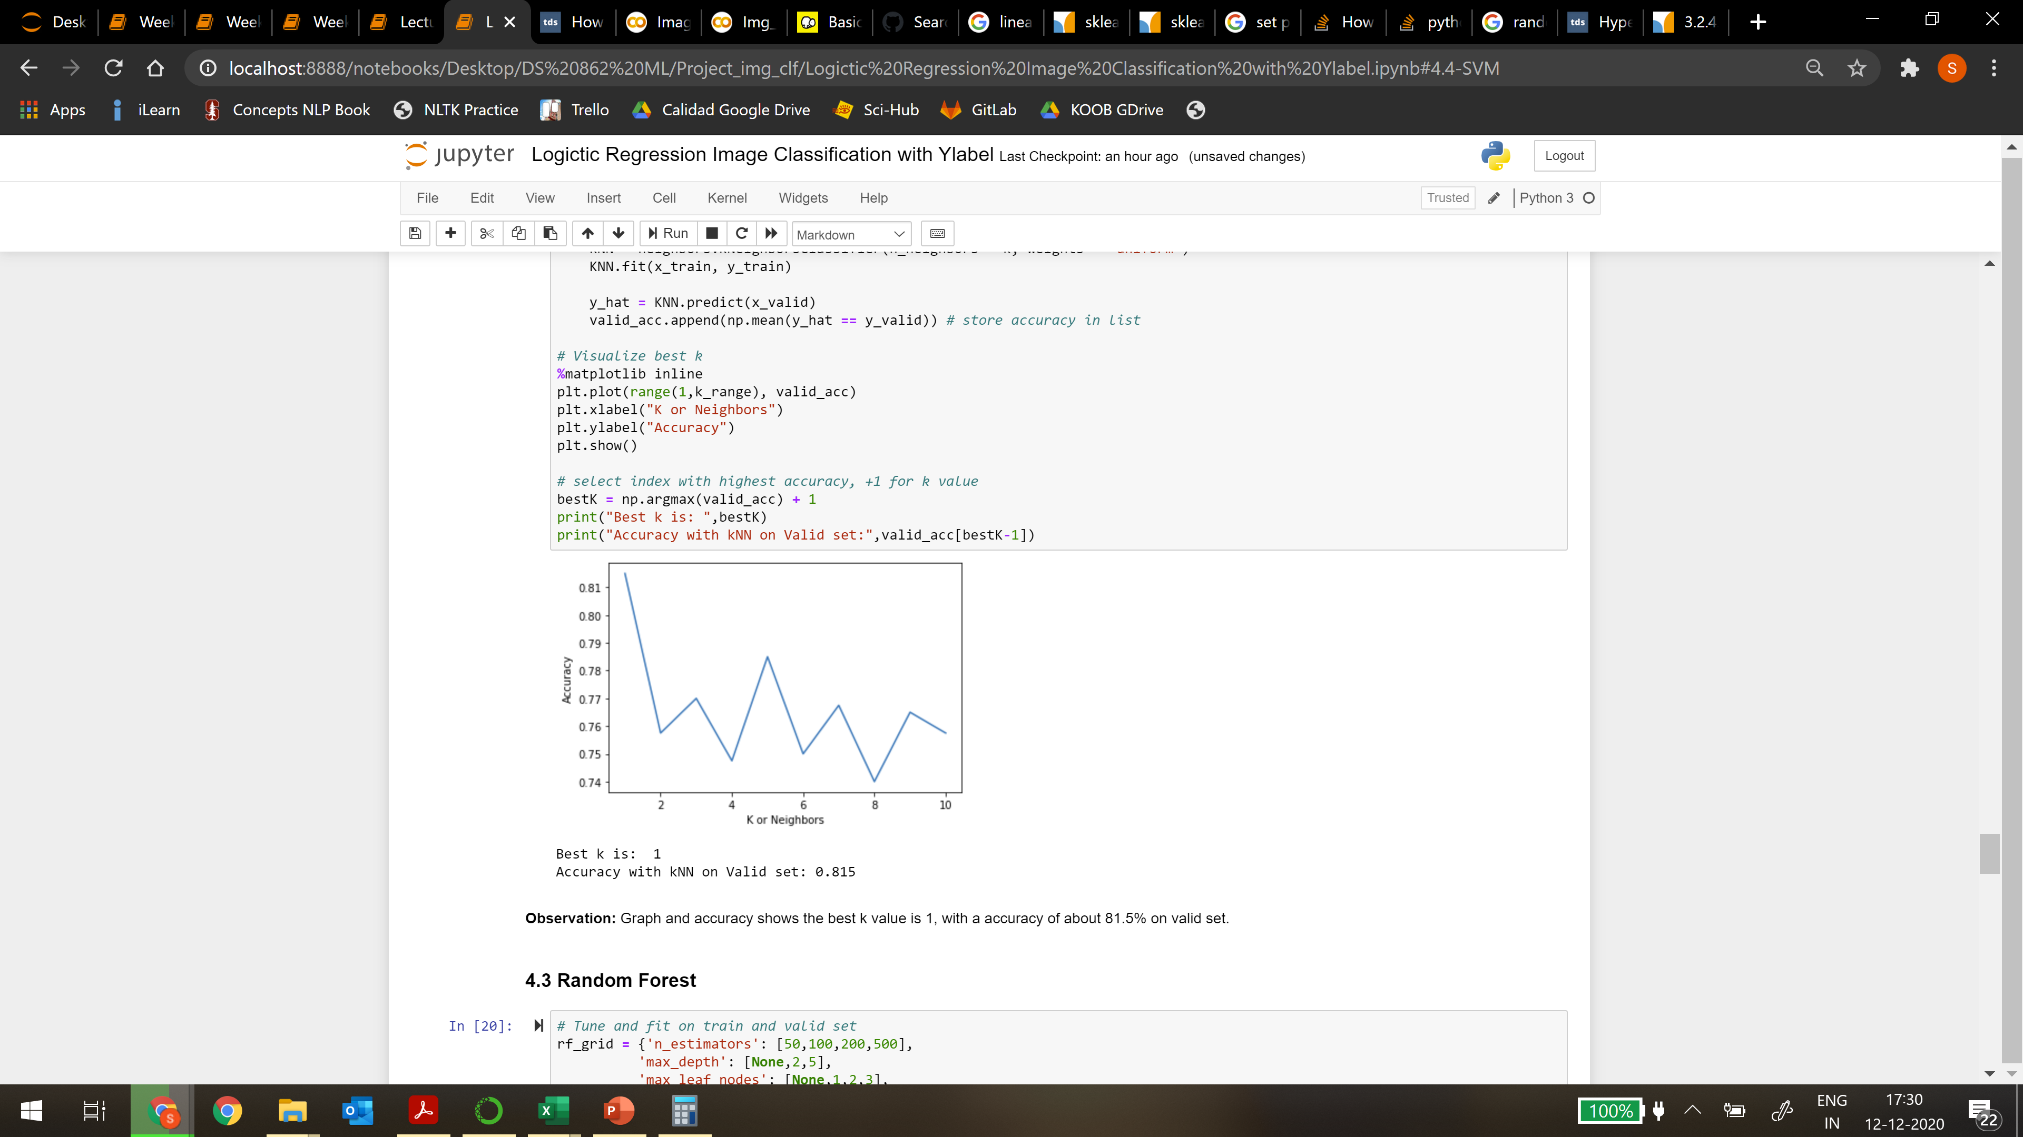



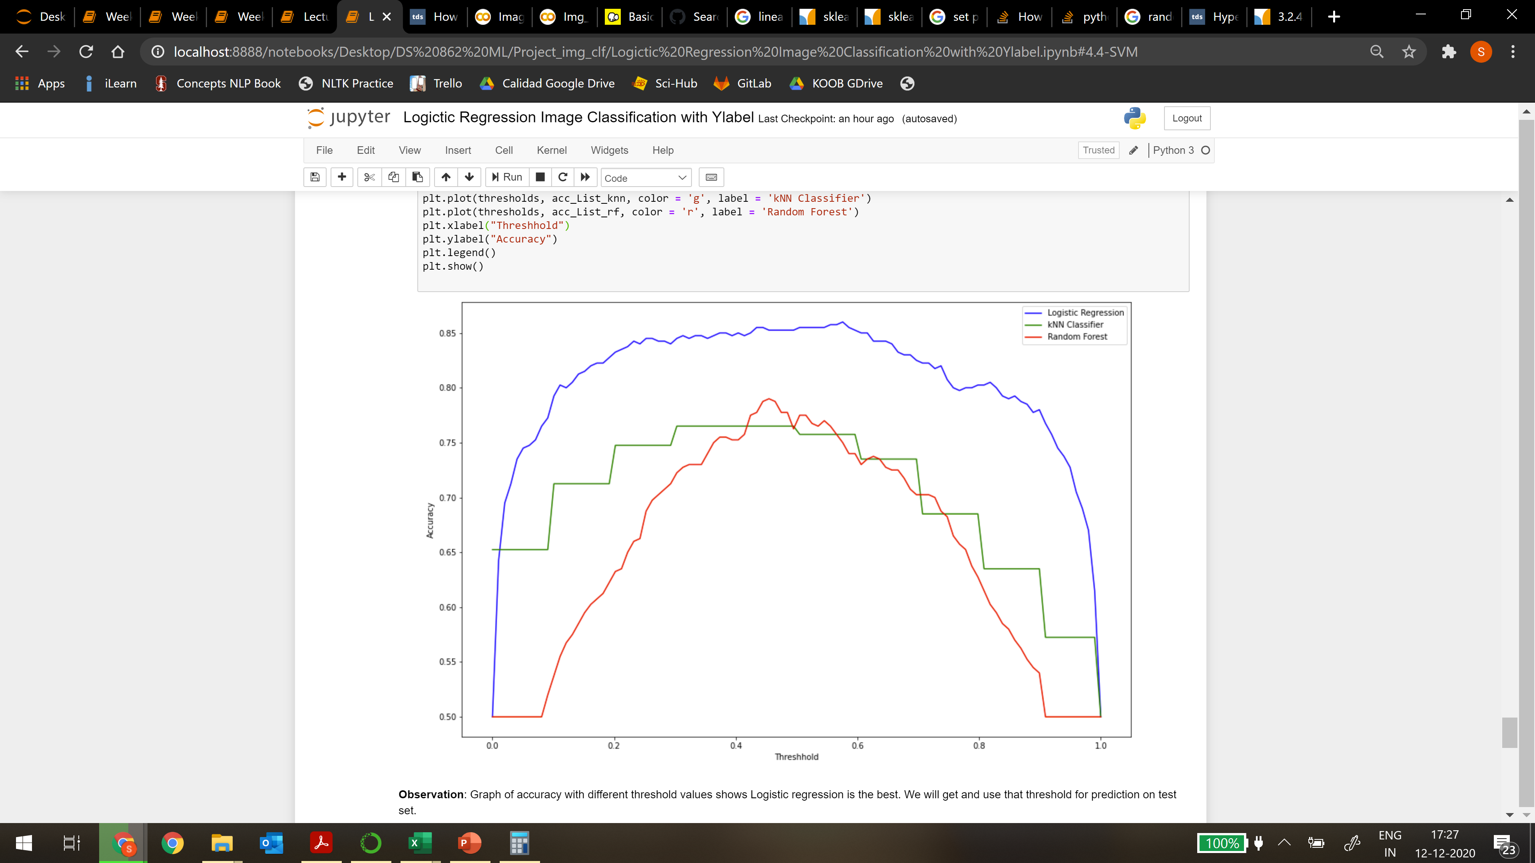



Work flow
Flatten images (1000, 64, 64) -> (1000, 4096) Train model
Hyperparameter tune: Grid search with 2-fold CV
Find & Predict with best parameters on Valid data
Perform same steps on all- Logistic, kNN, Random Forest, SVM
Best k = 1
Find best accuracy threshold (LR,KNN,RF)
Predict on test set
Compare accuracy across all classifiers to judge performance.
Best threshold ~.5
Notes:
Now we have the resized augmented images in 2d arrays and the encoded response label
Then we flatten the image to 1d array to make it ready for statistical ML methods

Slide 11
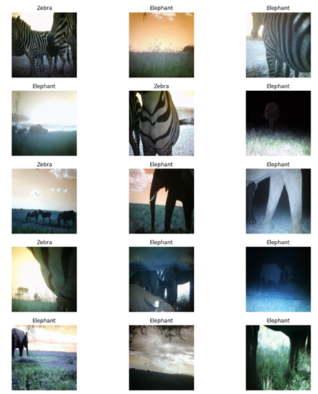
Part 1 : Result and Analysis
Model | Image Augmentation | Hyperparams | Threshold | Validation Accuracy | Test Accuracy
Logistic | Grayscale, 64x64 | {'max_iter': 100, 'solver': 'newton-cg'} | 0.57 | 0.855 | 0.8325
kNN | Grayscale, 64x64 | k = 1, weights='uniform' | 0.3 | 0.815 | 0.7975
RF | Grayscale, 64x64 | {'ccp_alpha': 0.01, 'max_depth': None, 'max_leaf_nodes': None, 'min_samples_leaf': 5, 'n_estimators': 50} | 0.45 | 0.8225 | 0.7275
Linear SVM | Grayscale, 64x64 | {'C': 0.01} | NA | 0.83 | 0.8325
SVC Poly | Grayscale, 64x64 | {'C': 0.5, 'coef0': 0, 'degree': 2} | NA | 0.855 | 0.8625
SVC RBF | Grayscale, 64x64 | {'C': 0.5, 'gamma': 0.1} | NA | 0.63 | NA
Observations
Test images some with small/no animal
Valid Accuracy LR = Poly SVM
Logistic Regression overfitting
Poly SVM performs best
What can be further done?
Notes:
Test images have data with no animal or animal being extremely far to be detected even by human eye.
Although accuracy score is same, Logistic Regression shows some overfitting and linear SVM performs best. it separates the classes using boundary linear or hyper-plane .

Slide 12
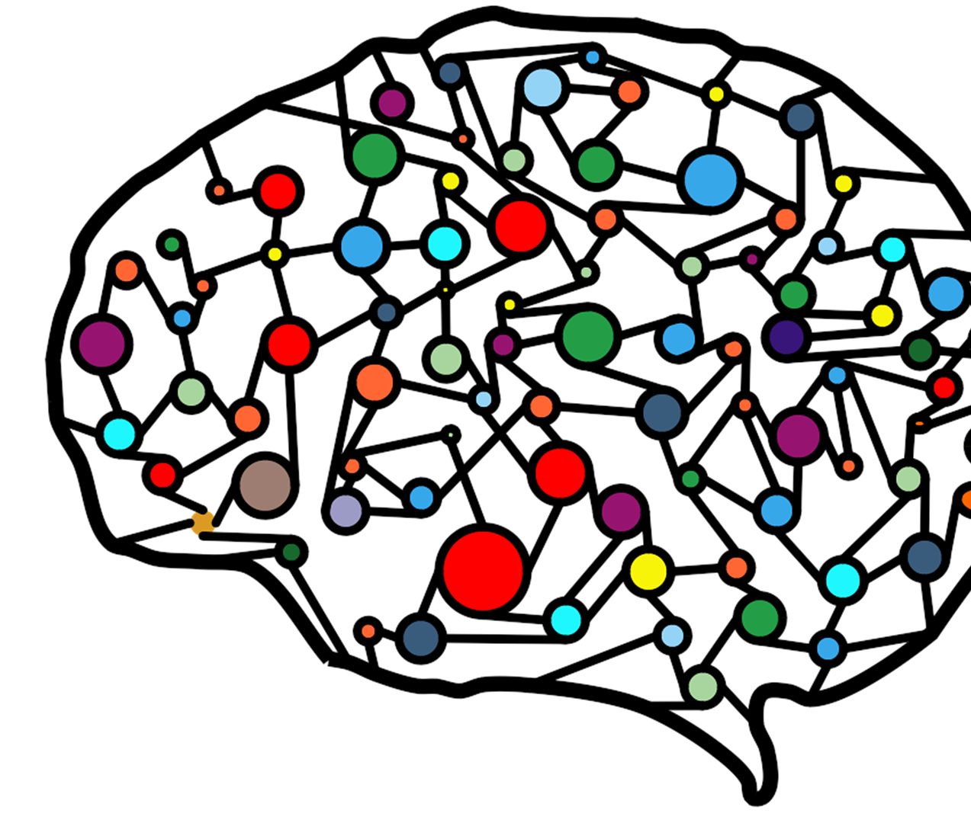
Part 2
Image classification using Deep Neural Networks

Slide 13
Convolutional Neural Networks (CNN)
Reduce the images into a form which is easier to process, without losing features which are critical for getting a good prediction.
Convolutional Neural Network has:
Convolutional layers
Pooling layers
Fully connected layer
ReLU layers
Notes:
Convolutional neural networks (CNN) is a special architecture of artificial neural networks and it is Most popular for image classification. Apart from input and output, a Convolutional Neural Network has 4 types of layers - Convolutional layers, ReLU layers, Pooling layers and a Fully connected layer.
. (It has been a primary algorithm for the advancements in Computer Vision The role of the ConvNet is to reduce the images into a form which is easier to process, without losing features which are critical for getting a good prediction)

Slide 14

CNN - Convolution Layer
The kernel is a filter that is used to extract the features from the images
Here Kernel/Filter, K =
The objective of the Convolution Operation is to extract the high-level features such as edges, from the input image.
1 0 1 0 1 0 1 0 1
Image source
Notes:
First part of convolution layer is Kernel/filter K which is involved in carrying out the convolution operation. The kernel is a matrix (a matrix of weights) that moves over the input data, performs the dot product with the sub-region of input data, and gets the output as the matrix of dot products. The objective of the Convolution Operation is to extract the high-level features such as edges, from the input image.

Slide 15

CNN - Convolution Layer
Image source
Notes:
In the case of images with multiple channels (e.g. RGB) Matrix Multiplication is performed between Kernel and Input channel and all the results are summed with the bias to give us a squashed one-depth channel Convoluted Feature Output.

Slide 16

CNN – Pooling Layer
Reduce spatial size of the Convolved Feature
two types of Pooling:
Max Pooling
Average Pooling
Image source
Notes:
Pooling layer is responsible for reducing the spatial size of the Convolved Feature. There are two types of Pooling: Max Pooling and Average Pooling. Max Pooling returns the maximum value from the portion of the image covered by the Kernel. On the other hand, Average Pooling returns the average of all the values from the portion of the image covered by the Kernel.
Figure shows 3x3 Max pooling over 5x5 convolved feature
Process till now enables model to understand the features. Next we are going to flatten the final output and feed it to regular neural network for classification purpose.

Slide 17
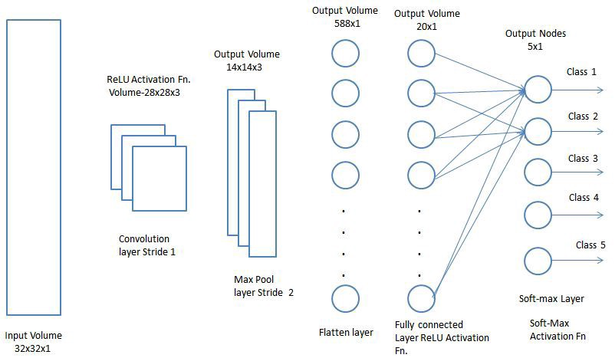
CNN - Fully Connected Layer (FC Layer)
Flatten the image into a column vector
Each neuron receives input from every element of the previous layer
Image source
Notes:
Now that we have converted our input image into a suitable form for our multi-level perceptron, we’ll flatten the image into a column vector. The flattened output is fed to a feed-forward neural network and backpropagation applied to every iteration of training.
(In a convolutional layer, neurons only receive input from a subarea of the previous layer.) In a fully connected layer, each neuron receives input from every element of the previous layer

Slide 18
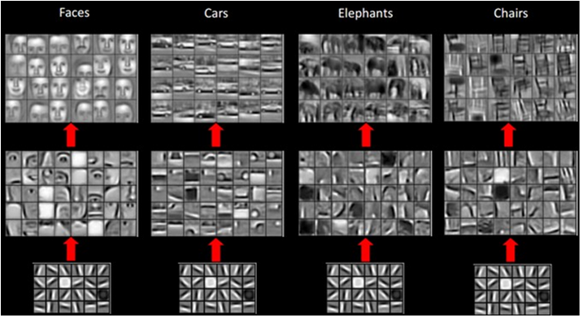
Architectures of CNNs
LeNet
AlexNet
VGGNet
GoogLeNet
ResNet
ZFNet
This Photo by Unknown Author is licensed under CC BY-SA
Notes:
There are various architectures of CNNs. Like Lenet, Alexnet, VGGnet, GogleNet, ResNet, and ZFNet.
The models trained using these architectures on the ImageNet data can be used task specific classification through transfer learning.

Slide 19
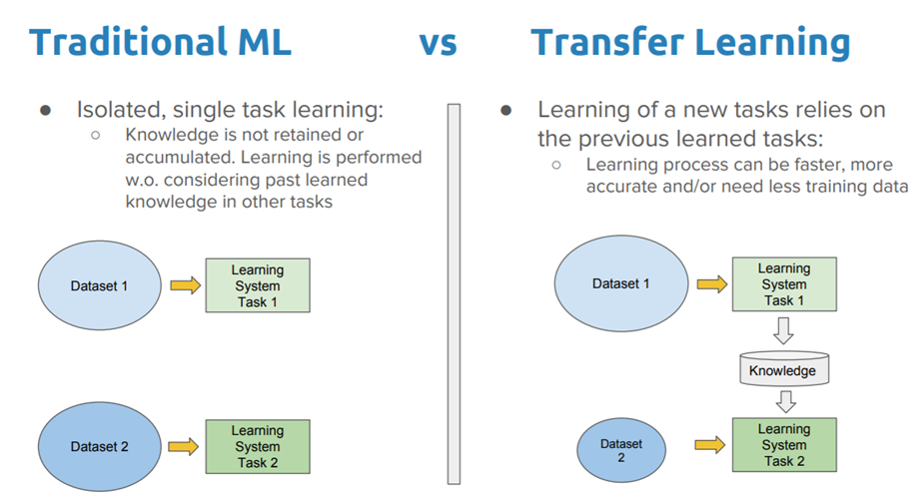
Transfer Learning
Pre-trained deep neural networks for Computer Vision
VGG-16
VGG-19
Inception V3
ResNet-50
Xception
Image source
Notes:
The traditional machine learning techniques try to learn each task from scratch, while transfer learning techniques try to transfer the knowledge from some previous tasks to a target task.
There are some famous Pre-trained deep neural networks for Computer Vision, for example
VGG-16
VGG-19
Inception V3
ResNet-50
Xception

Slide 20
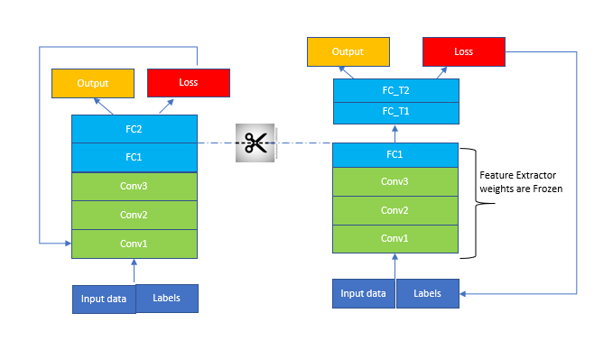
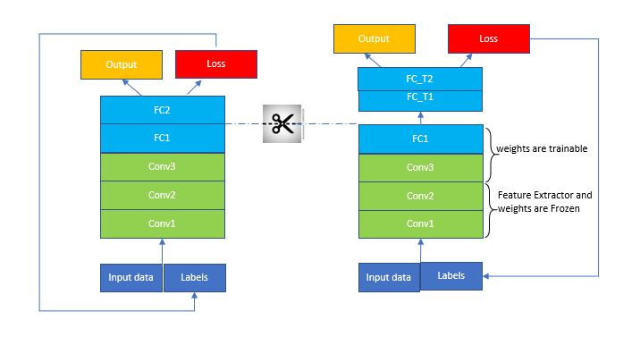
Transfer Learning
Implement transfer learning:
Remove the last predicting layer of the pre-trained model and replace them with our own predicting layers. Pretrained model layers are frozen.
Finetune transfer learning model:
Unfreeze few top layers of pretrained model.
Notes:
To implement transfer learning model, weights of the pre-trained models are used as a feature extractor and they are frozen and are not updated during the training
Initial lower layers of the network learn very generic features from the pre-trained model. Higher layers are used for learning task-specific features.

Slide 21
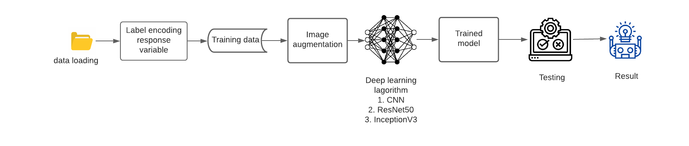
Flowchart – Our Approach Using Deep Learning
Model building:
Deep Learning
Convolutional Neural Network (CNN)
Transfer learning
ResNet50
InceptionV3

Slide 22
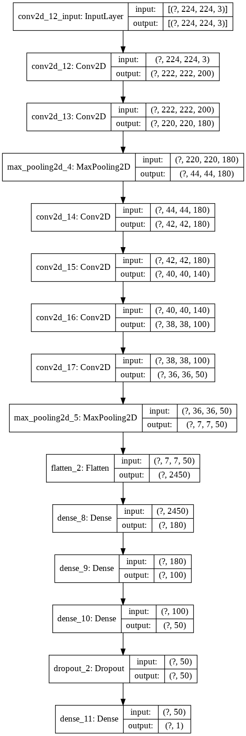

Image Classification using simple CNN
Model | Image augmentation? | Optimizer | Learning rate | Validation accuracy | Test accuracy
CNN | No | Adam | 0.0001 | 0.89 | 0.8875
CNN | No | Adam | 0.00001 | 0.8275 | 0.8375
CNN | Yes | Adam | 0.0001 | 0.8575 | 0.8525
CNN | No | RMSprop | 0.0001 | 0.9125 | 0.8725
CNN | Yes | RMSprop | 0.00001 | 0.8675 | 0.86
Fig. Plot of CNN Model
Notes:
This slide shows the Summary of results for the different CNN models that we tested. We tried 5 variations with input data. Variations with learning rate, optimizer and with input image augmentation. And we found best accuracy of 88.75% on the test set for the CNN model with optimizer Adam, learning rate as 0.0001 and input images without image augmentation.

Slide 23
Image Classification using ResNet50 and InceptionV3
Model | Image augmentation? | Optimizer | Learning rate | Validation accuracy | Test accuracy
ResNet50 | No | RMSprop | 0.00001 | 0.75 | 0.75
ResNet50 | Yes | RMSprop | 0.00001 | 0.7475 | 0.745
ResNet50 | Yes | Adam | 0.0001 | 0.7425 | 0.7175
InceptionV3 | Yes | Adam | 0.0001 | 0.93 | 0.94
Notes:
WE used ResNet50 as a pretrained model for our image classification task and we did variations with using image augmented input and unfreezing few layers of the pre-trained model. We achieved best accuracy for the model without unfreezing any pre-trained layer and without image augmented output. The accuracy with CNN model is better than using pre-trained model however there is lot of scope in tuning hyper parameters. Also it might be possible possible, that feature extraction learned from resnet isnt really transferable for this image classification task.

Slide 24
Conclusion:
Although most of the models, achieve more than 80% accuracy, the one achieved with transfer learning using InceptionV3 (94% accuracy )is best overall.
Future Scope
Explore Different pre-trained models using other transfer learning
Hyperparameter tuning
Ensemble modeling (voting classifier, stacking) using weak learners like logistic, KNN
Different evaluation metrics
Notes:
Although most of the models, achieve more than 80% accuracy, the one achieved with transfer learning using InceptionV3 is best overall. With the InceptionV3 pretrained model we could achieve 93% accuracy on validation set and 94% accuracy on test set. Therefore, transfer learning is an effective method for image classification.

Slide 25


Slide 26
